Slide 1
Chapter 19 Root Finding
By
Hyung Jae (Chris) Chang
Troy University

Slide 2
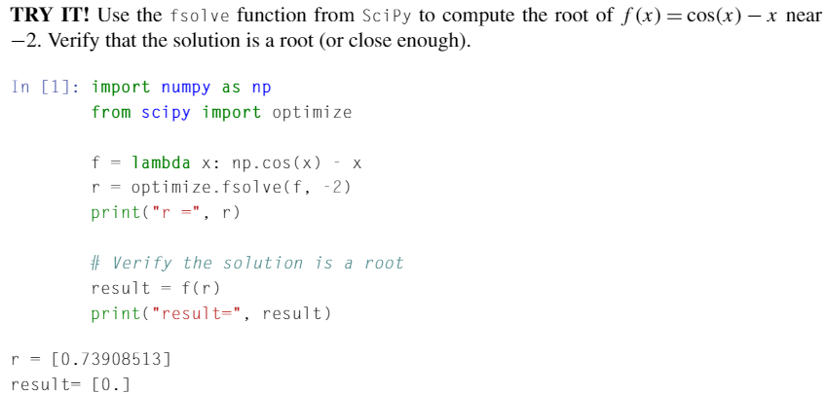
Introduction
The root or zero of a function, f(x): x_{r} such that f(x_{r}) = 0.
For some functions, it is clear finding the root of a function.
f(x) = x² – 9 → the roots are 3 and -3
For some functions, determining an analytic or exact solution for the roots of functions can be difficult.
f(x) = cos(x) – x

Slide 3
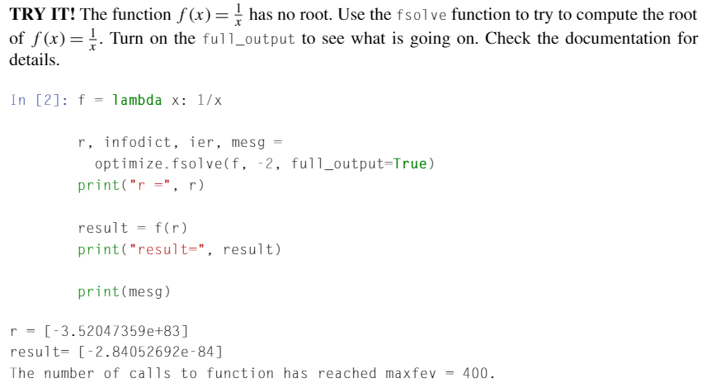
Introduction (cont.)
The value r returned is not a root.
In the code above, full_output option is used to see more information; “The number of calls to function has reached maxfex=400.”

Slide 4
Tolerance
Error: a deviation from an expected or computed value.
Tolerance: the level of error that is acceptable for an engineering application.
“Computer program has converged to a solution when it has found a solution with an error smaller than the tolerance.”
For computing roots, we want an x_{r} such that f(x_{r}) is very close to zero.

Slide 5
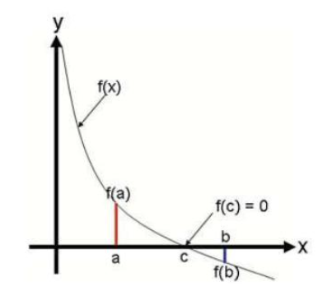

Bisection Method
Intermediate Value Theorem: if f(x) is a continuous function between a and b, and sign(f(a)) $≠$ sign(f(b)), then there must be a “c”, such that a<c<b and f(c)=0.

Slide 6
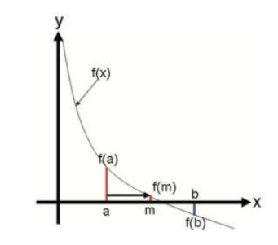
Bisection Method (cont.)
Bisection method uses the intermediate value theorem iteratively to find roots.
By the intermediate value theorem, there must be a root in the open interval (a,b) under the following conditions.
Let f(x) be a continuous function, and a and b be real scalar values such that a<b.
f(a)>0 and f(b)<0

Slide 7
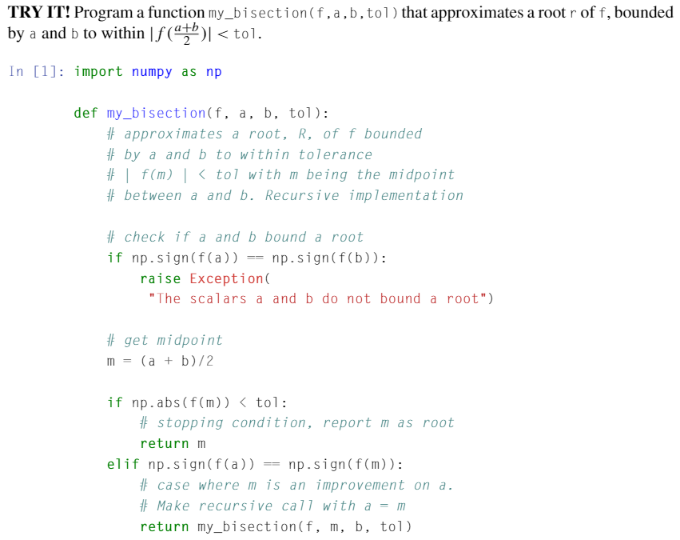

Bisection Method in Python – Example 1

Slide 8
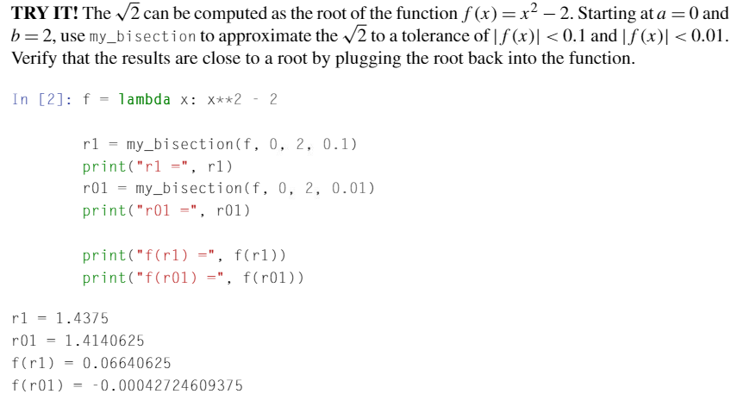
Bisection Method in Python – Example 2

Slide 9


Newton-Raphson Method
Let f(x) be a smooth function and x_{r} be an unknown root of f(x).
Assume that x₀ is a guess for x_{r} → most likely, x₀ will not be a root.
Based on this, we want to find x₁ which is an improved guess from x₀.
If x₀ is “close enough” to x_{r}, then we improve upon it by taking the linear approximation of f(x) around x₀ which is a line and finding the intersection of this line with the x-axis.
The linear approximation of f(x) around x₀

Slide 10

Newton-Raphson Method (cont.)
A Newton step computes an improved guess x_{i} using the previous guess x_{i-1}.
The Newton-Raphson Method of finding roost iterates Newton steps from x₀ until the error is less than the tolerance.
f
f’

Slide 11
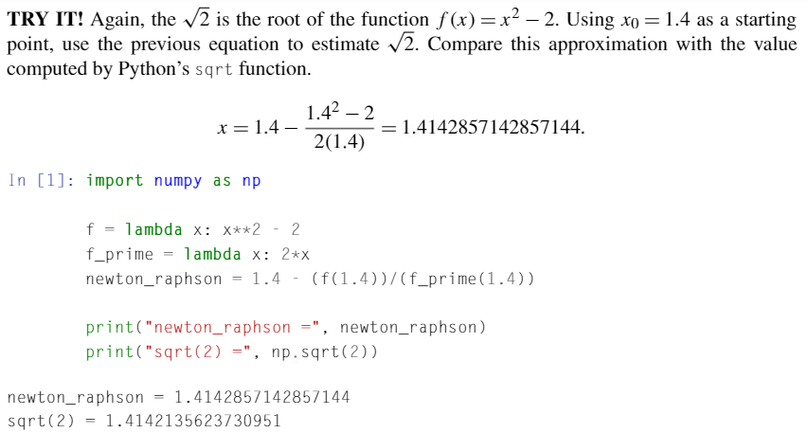
Example 1

Slide 12
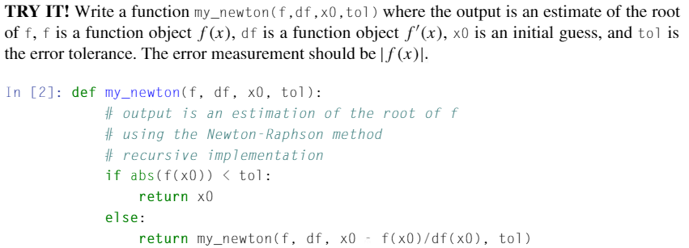
Example 2

Slide 13
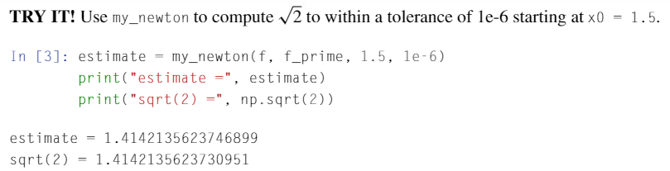
Example 3

Slide 14
Limitation of Newton-Raphson Method
Then, how do we make an initial guess which is close enough to the root? → impossible unless we have some special information about the function known a priori (e.g. “the function has a root close to x=0”.)
If the derivative at a guess is close to zero, then the Newton step will be very large and probably lead far away from the root.
Depending on the behavior of the function derivative between x₀ and x_{r}, the Newton-Raphson method may converge to a different root than x_{r} which may not be useful for the engineering application being considered.

Slide 15
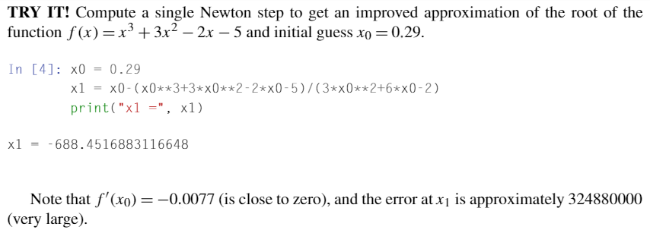
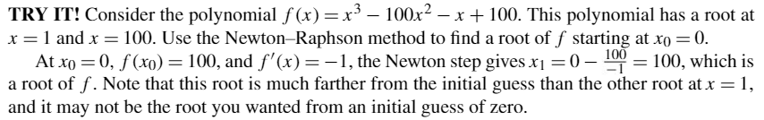
Limitation of Newton-Raphson Method (cont.)

Slide 16
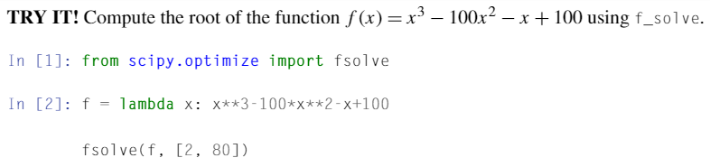
Root Finding in Python
Python has root-finding functions: f_solve function from scipy.optimize.
f_solve function takes in many arguments among which the most important two are
The function that you want to find the root
The initial guess

